Slide 1
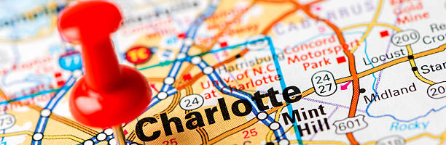
CRIME
Charlotte, North Carolina
Angelique N Joshua M Brianna B Nicoletta S
TEAM GRYFFINDOR

Slide 2


The Idea
Crime mapping
Predictive policing
visualize crime patterns
identify hotspots
allocate resources more effectively
formulate strategies
tactical analysis (e.g. crime forecasting, geographic profiling).
Raising awareness within our communities and serving as an aide in finding safer environments for ourselves and our families
Notes:
Crime analysis is used to understand patterns of incarceration and recidivism, help target resources and programs, evaluate crime prevention or crime reduction programs, and further understanding of causes of crime.

Slide 3


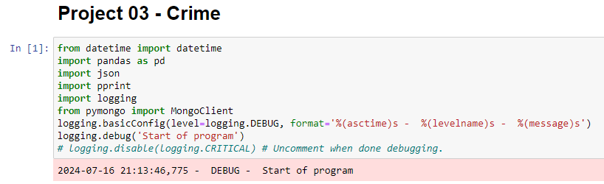
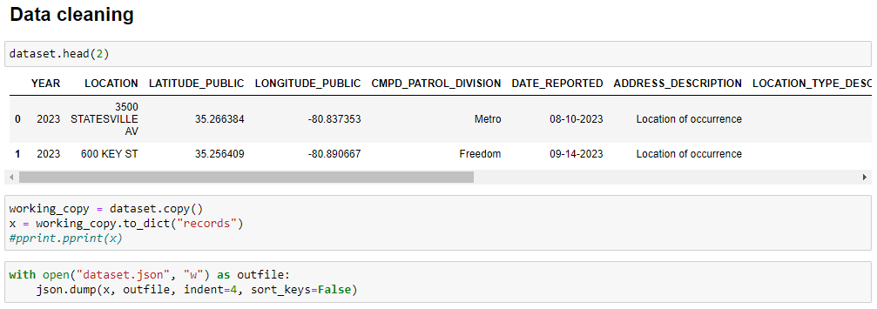
Data Cleaning

Slide 4

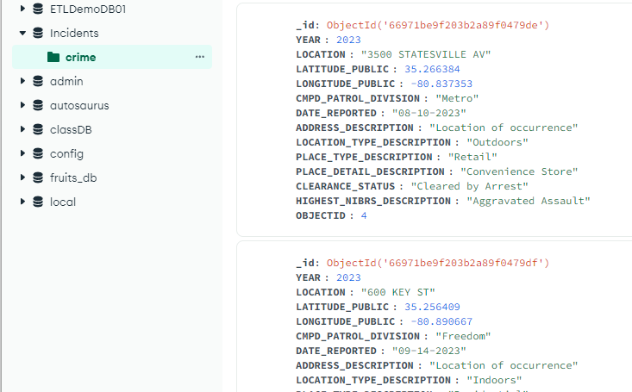
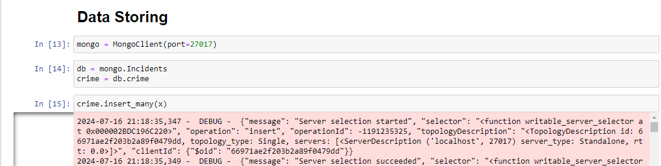
Data Storing

Slide 5

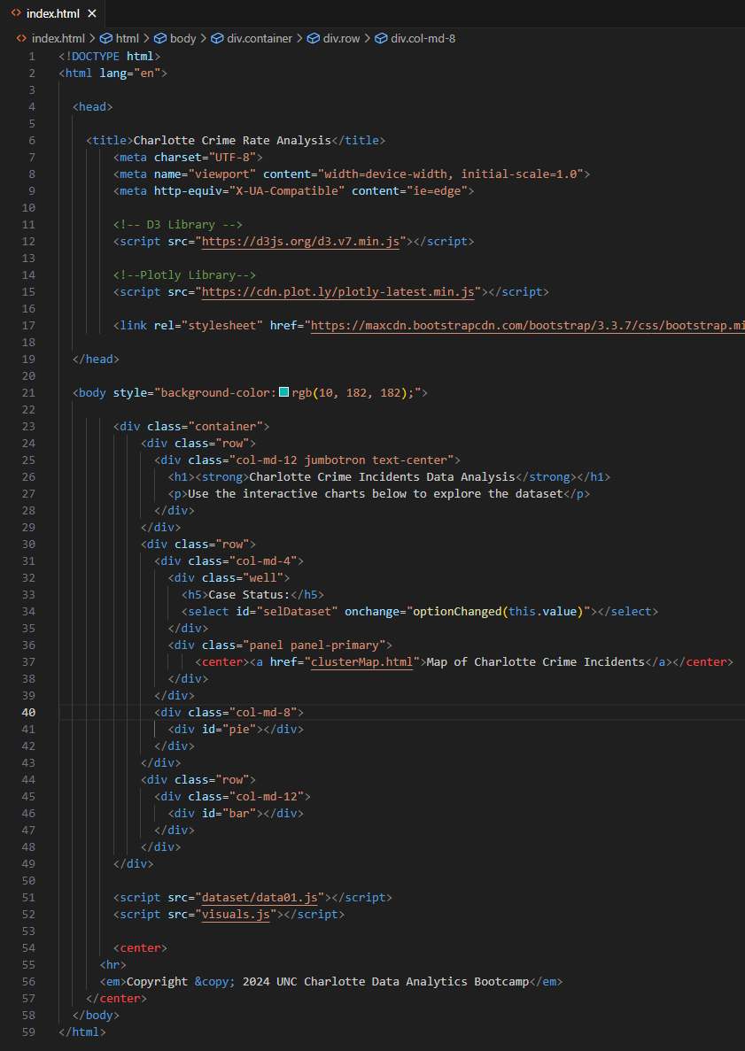
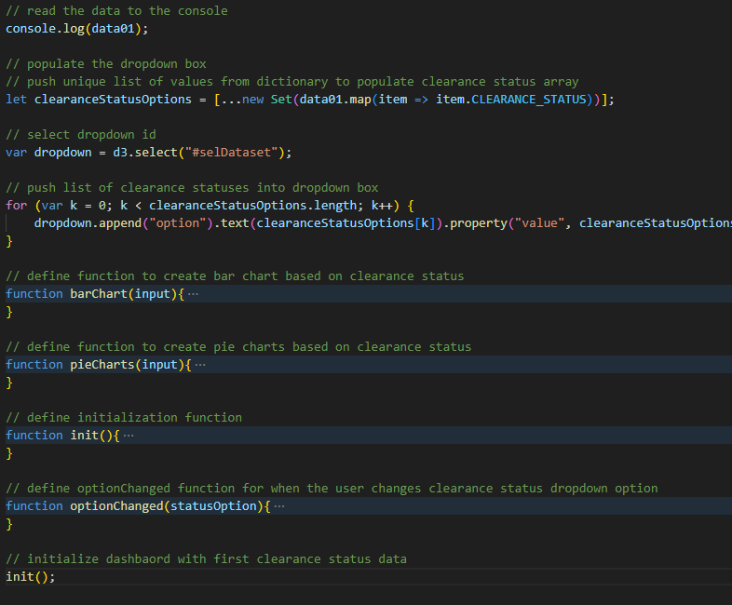
Coding approach

Slide 6
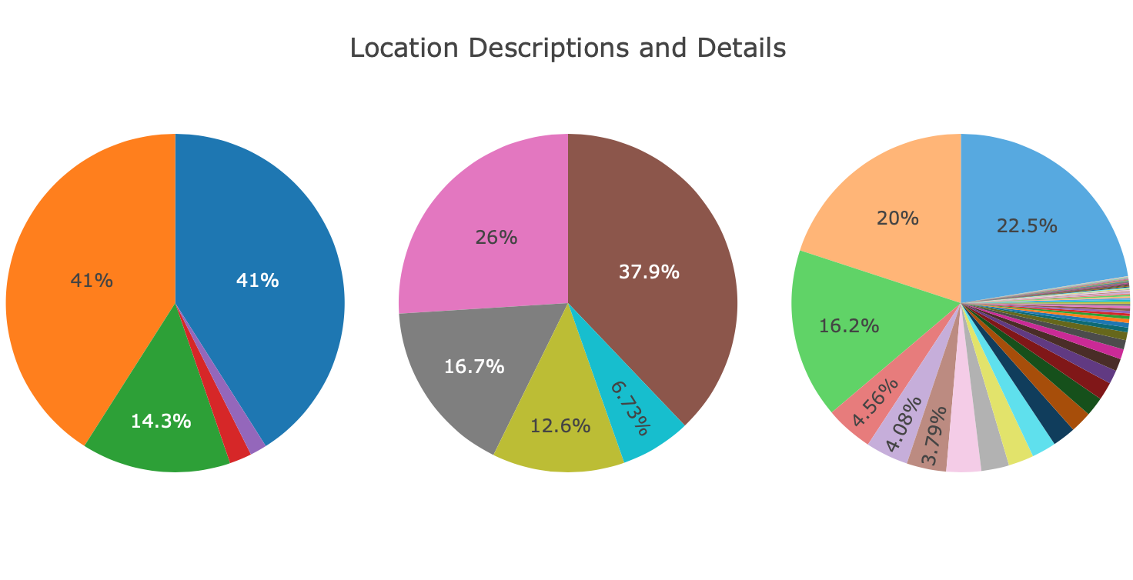

Slide 7

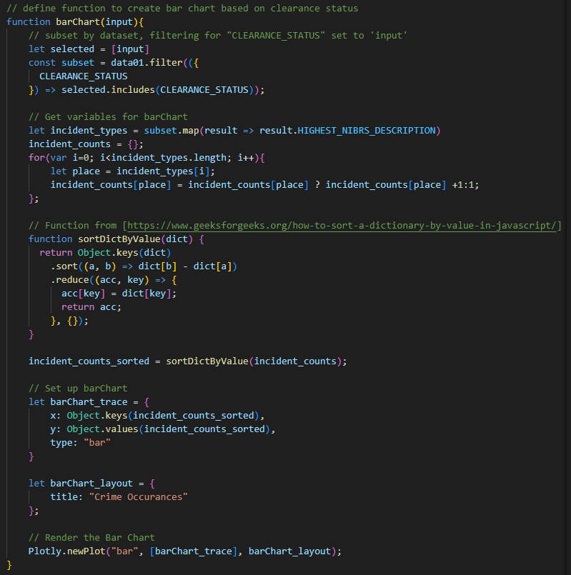
Coding approach

Slide 8
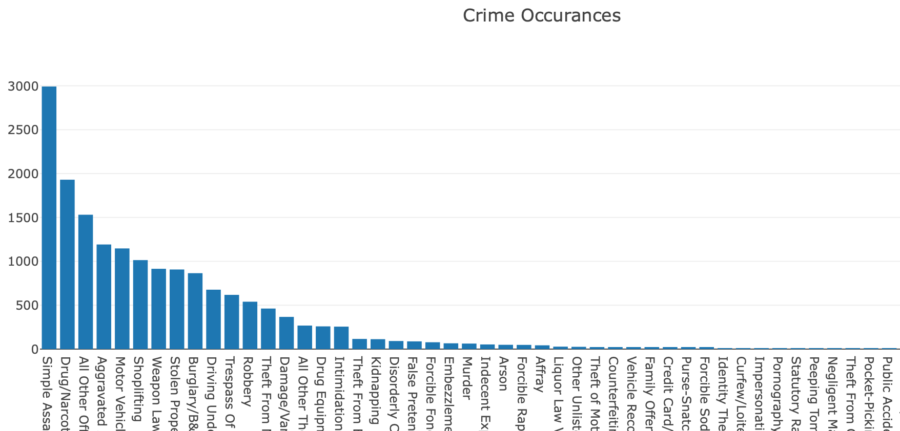
Notes:
[Cleared by Arrest] The Top 10 crimes in this category, 4 are theft related, 2 are assault related. [Open] The Top 3 are theft related, 1st is 'theft from vehicle', 3rd is vehicle theft. Lock your doors! [Exceptional Clear] Missing persons ranks as the highest specific case. [Cleared by Arrest by Another Agency] Shoplifting ranks #1 with twice the number of case of the second highest crime of 'simple assault'.

Slide 9

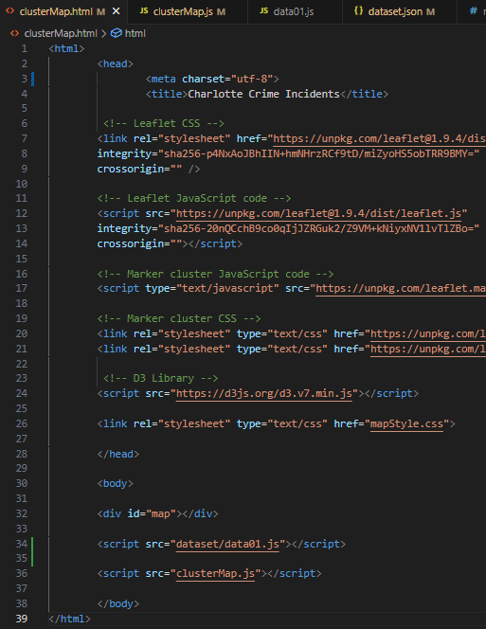
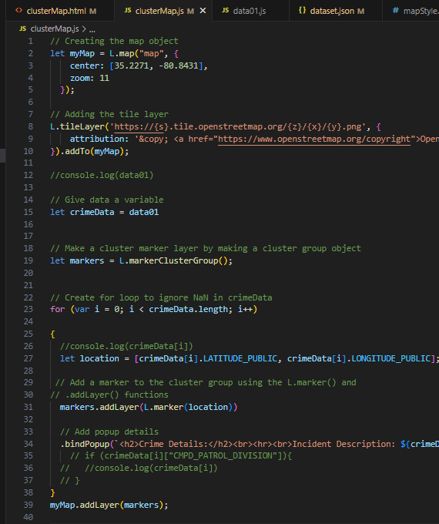
Coding approach

Slide 10
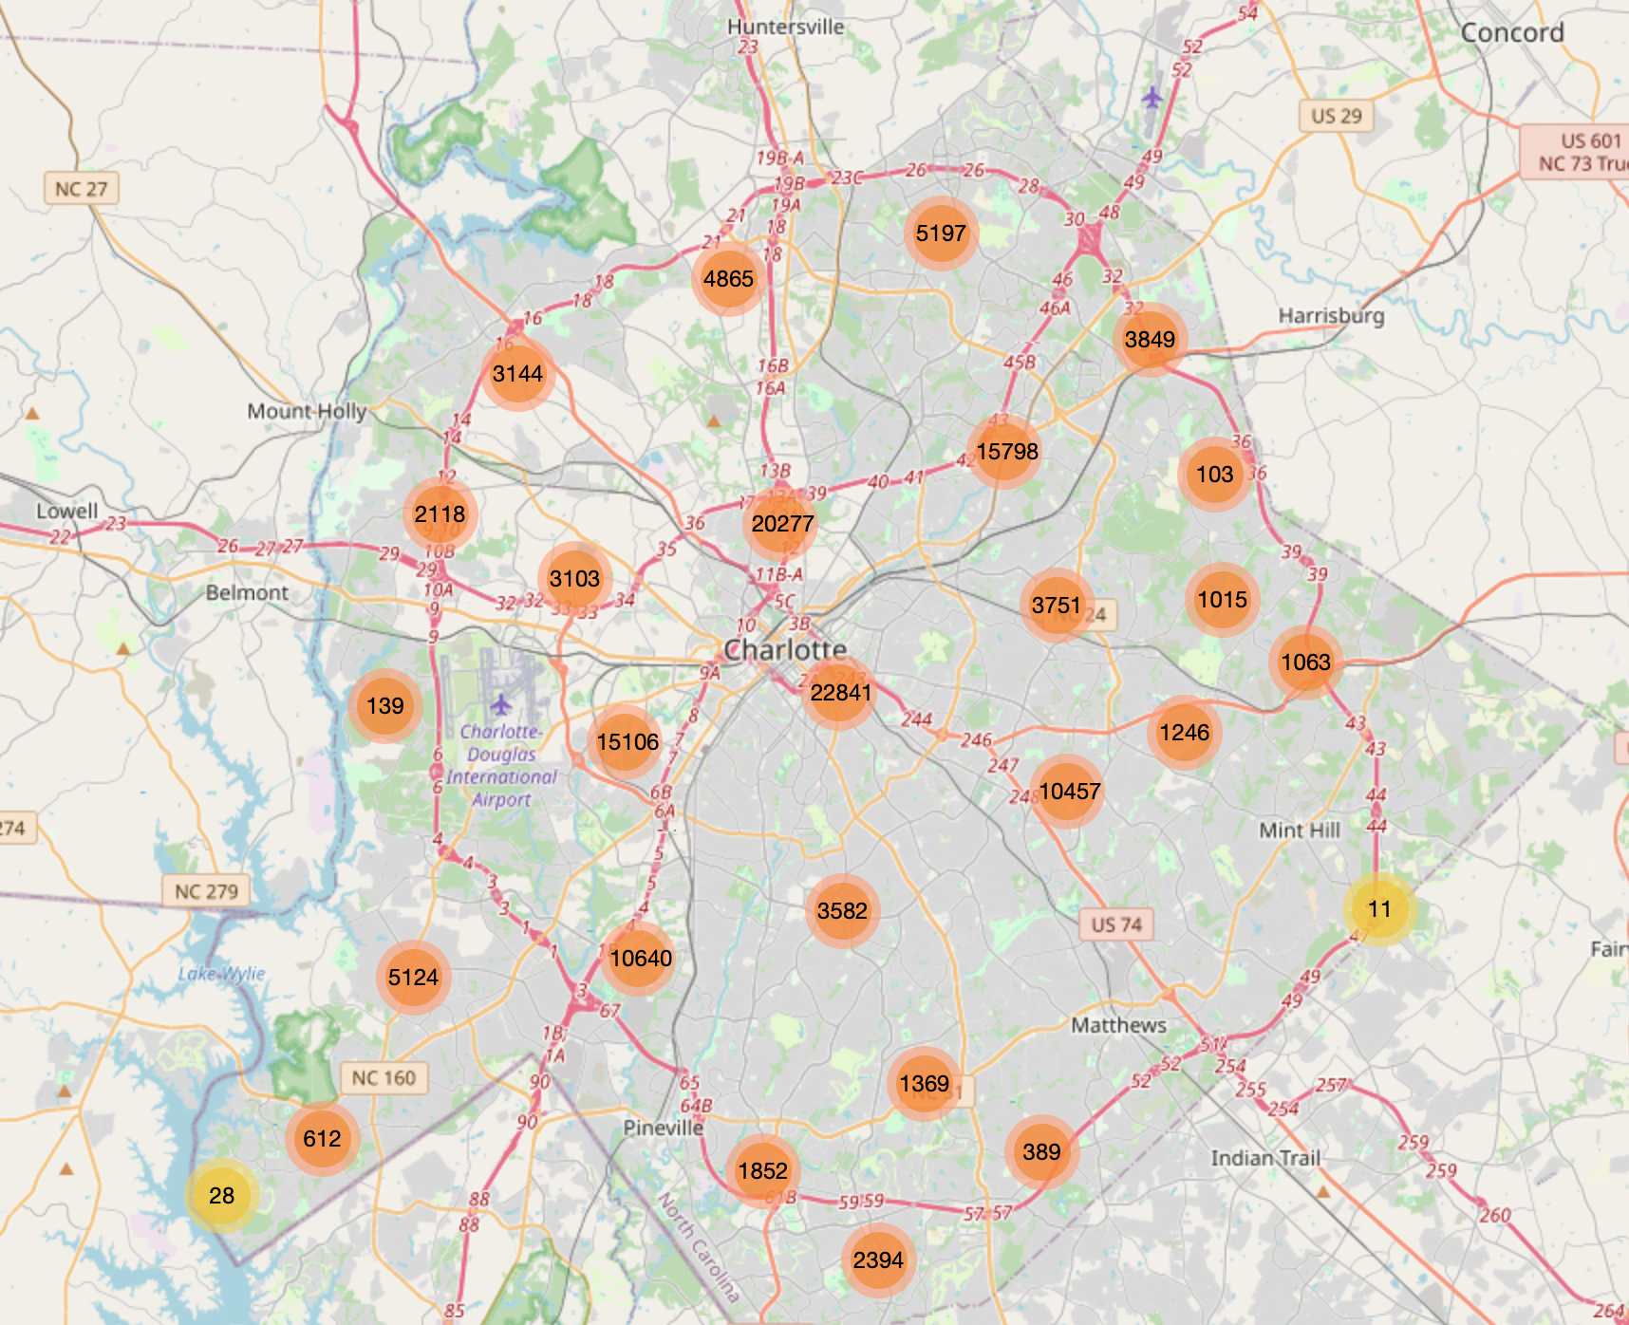
Mapping

Slide 11

Conclusion
Technology is the future in
creating safe communities
Better policing
Better preventative measures
Better resource allocation
Better environments within our cities
This Photo by Unknown Author is licensed under CC BY-SA

Slide 12
Work Cited
https://data.charlottenc.gov/datasets/d22200cd879248fcb2258e6840bd6726_0/explore?location=35.261109%2C-80.809400%2C9.97

